Slide 1

Internetové služby
Základný prehľad

Slide 2

Dnes sa naučíme...
Vysvetliť čo je to internetová služba
Vymenovať základné IS
Rozdeliť IS podľa rôznych kritérií

Slide 3

Prečo má internet taký význam?

Slide 4

Prečo má internet taký význam?

Slide 5

Opakovanie
Čo je to komunikácia?

Slide 6


Opakovanie
Čo je to komunikácia?
Čo je informácia?

Slide 7

Opakovanie
Čo je to komunikácia?
Čo je informácia?
Ako možno informáciu reprezentovať?

Slide 8
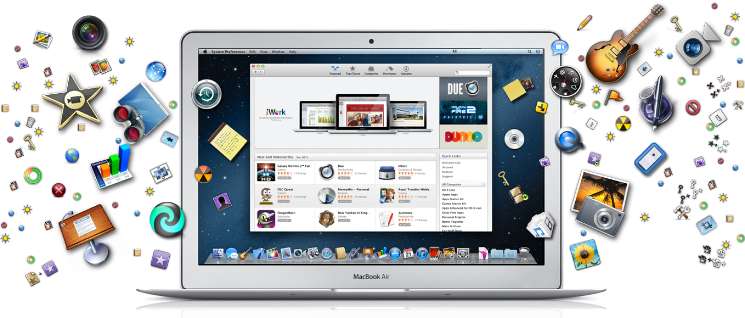
Opakovanie
Čo je to komunikácia?
Čo je informácia?
Ako možno informáciu reprezentovať?
Aké (offline) programy používame na spracovanie informácií?

Slide 9
Repetition
Choose a term and try to explain it using your own words:
communication
multimedia
information
offline app
software
freeware
open source
service
product
online
cloud
computer file
internet
connection

Slide 10


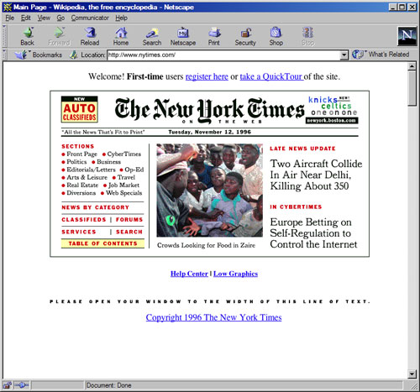


What is internet service?

Slide 11
Internet services
Which internet services do you know?

Slide 12
Internet services
WWW services / web services
Email services
Chat, forum, audio/video conference
File hosting/sharing
Multimedia streaming
Social networks
Maintenance services (speedtest)

Slide 13
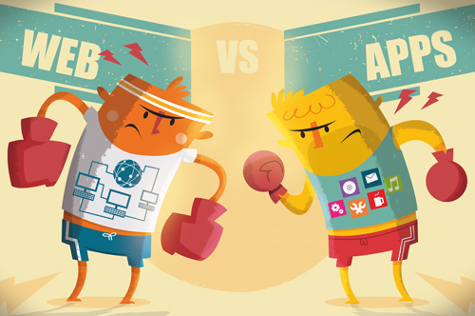
Web & App based services
Web services
Access via web browser
App based services
Access via dedicated program
Pros? Cons?

Slide 14

Internet services
Service categories?

Slide 15
Internet services

Slide 16
Internet services
Communication services
Direct
Chat/Messenger, VoIP Calls, VideoCalls/Teleconference
Indirect
Email, Forum, Wiki

Slide 17
Internet services
Communication services
Direct
Chat/Messenger, VoIP Calls, VideoCalls/Teleconference
Indirect
Email, Forum, Wiki
Information services
Information sources
Web pages (WWW), File hosting, databases, P2P sharing networks
Information retrieval
Search engines, catalogues

Slide 18
Internet services
Communication services
Direct
Chat/Messenger, VoIP Calls, VideoCalls/Teleconference
Indirect
Email, Forum, Wiki
Information services
Information sources
Web pages (WWW), File hosting, databases, P2P sharing networks
Information retrieval
Search engines, catalogues
Other services
Maintenance/troubleshooting
Remote computing (cloud computing)
APIs (application interfaces)

Slide 19
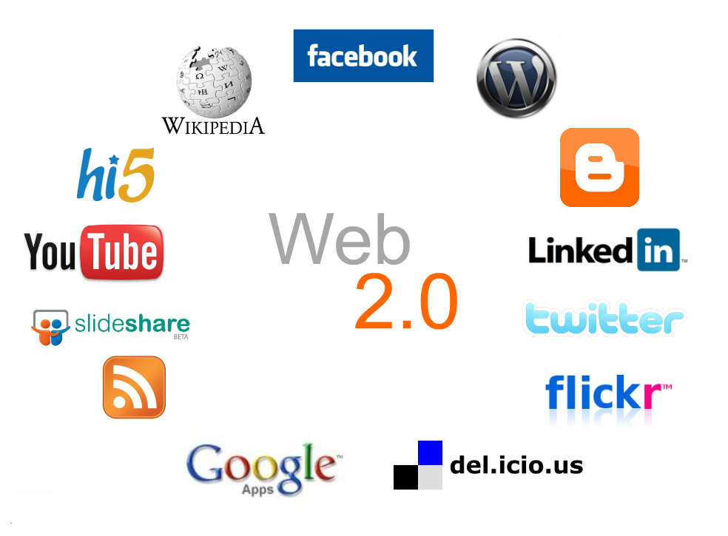

Slide 20
Task
Find at least two of each of these web-based internet services:
Search engine
Catalogue
File hosting
Email service
Social network
Online document editor (office)
Webpage hosting
File convertor
Online calculator
Knowledge engine

Slide 21

Thank you for your cooperation!
See you next time!
Email: puheim.gymes@outlook.com

